Slide 1
Manifestations of Alimentary Tract
By
Dr. Hussein ALNaji

Slide 2

Dysfunction
Inanition is the major physiologic effect of (alimentary dysfunction when the disease is chronic), (dehydration is the major effect in acute diseases), and (shock is the important physiologic disturbance in hyper acute diseases).
Other manifestations include abnormalities of prehension, mastication, and swallowing; and vomiting, diarrhea, hemorrhage, constipation, and scant feces.

Slide 3
Abnormalities Of Prehension, Mastication, And Swallowing Prehension is the act of grasping for food with the mouth (lips, tongue, and teeth). It includes the ability to drink. Causes of faulty prehension include:
Paralysis of the muscles of the jaw or tongue
Malposition of incisor teeth caused by the following:
Inherited skeletal defect (inherited displaced molar teeth, inherited congenital osteopetrosis)
Rickets

Slide 4
3. Absence of some incisor teeth
4. Pain in the mouth caused by the following:
Stomatitis, glossitis
Foreign body in mouth
Decayed teeth, e.g., fluorosis
5. Congenital abnormalities of tongue and lips:
Inherited harelip
Inherited smooth tongue of cattle.
A simple examination of the mouth usually reveals the causative lesion. Paralysis is indicated by the behavior of the animal as it attempts to ingest feed without success. In all cases, the animal is hungry and attempts to feed but cannot do so.

Slide 5

Mastication may be painful and is manifested by slow jaw movements interrupted by pauses and expressions of pain if the cause is a bad tooth, but in a painful stomatitis there is usually complete refusal to chew. Incomplete mastication is evidenced by the dropping of food from the mouth while eating and the passage of large quantities of undigested material in the feces.

Slide 6
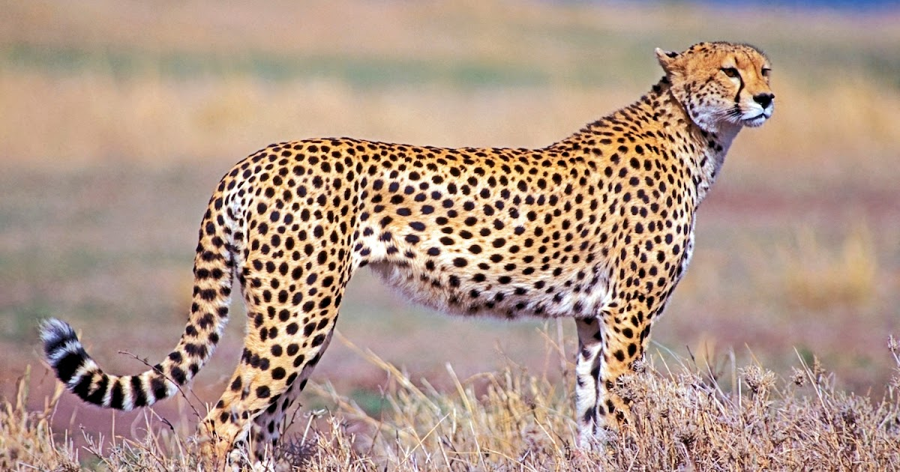
Dysphagia (difficulty in eating/ swallowing).
Dysphagia is manifested by forceful attempts to swallow accompanied initially by extension of the head, followed by forceful flexion and violent contractions of the muscles of the neck and abdomen.
Causes Of Dysphagia And Inability To Swallow
Foreign body, tumor, or inflammatory in pharynx or esophagus
Painful condition of pharynx or esophagus
Esophageal obstruction by impacted feed material
Esophageal dilatation caused by paralysis
Esophageal diverticulum
Esophageal spasm at site of mucosal erosion.

Slide 7

Excessive Salivation
Excessive salivation (ptyalism) is a sign of many pathologic conditions.
The volume of saliva may be normal, but if it is not being swallowed, salivation can appear excessive.
Local Causes Of Drooling Salivation
Foreign body in mouth or pharynx
Ulceration, deep erosion or vesicular eruption of the oral mucosa
Inability to swallow (esophageal abnormality)

Slide 8
Systemic Causes Of Excessive Salivation
Poisonous trees and poisonous plants
Fungal toxins, e.g.,
Iodism
Watery mouth of lambs
Sweating sickness
Methiocarb poisoning.
Ptyalism may be a clinical sign in rabies, pseudorabies, meningoencephalitis, and slaframine toxicity. Mercury, iodine, lead, copper, and arsenic toxicity.

Slide 9
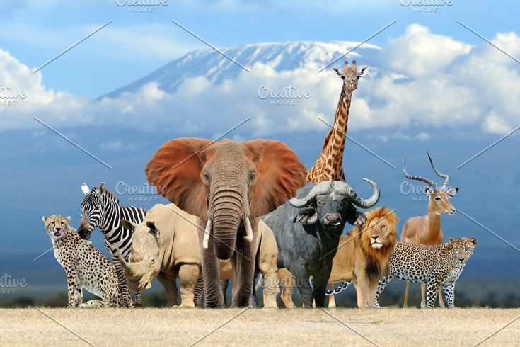
THANK YOU

